Slide 1

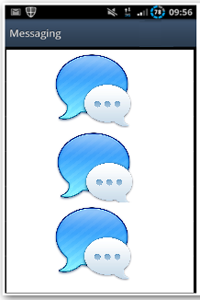

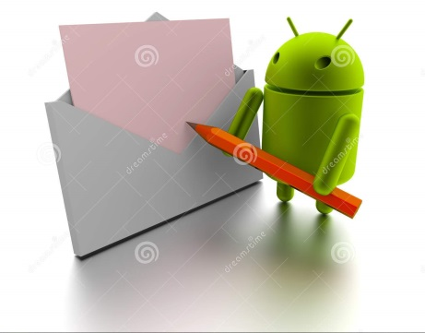
Test Cases
The Test Cases focus on these Features
Messages
Conversation: 1 or more messages
Features
Validations
Message Manager

Slide 2

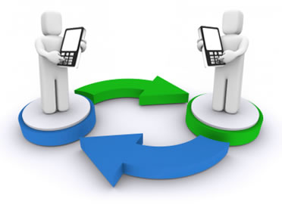
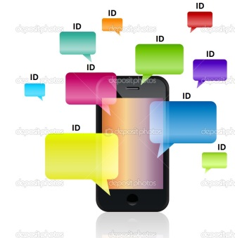

Test Cases
The Test Cases focus on these Features
Text message
Sender
phone #
Receiver
phone #
Message
ID message
Time stamp

Slide 3


Test Cases
The Test Cases focus on these Features
Unsent
message
Draft message
Further access to edit
and submit

Slide 4
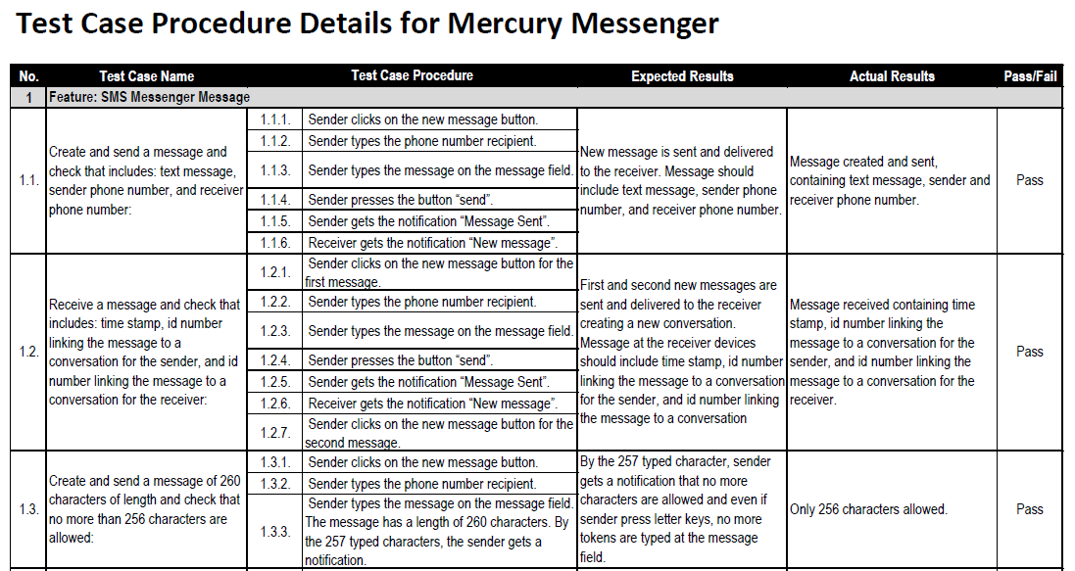
Test Cases
How we documented each Test Case

